Slide 1
Effective communication
Himanshu Singh
(M.Sc. CS 1st sem.)
23419CMP008

Slide 2
AGENDA
What is Communication?
Effective Communication
​Barriers of Effective Communication
Miscommunication
​Strategies for Mitigating Miscommunication
Guidelines

Slide 3
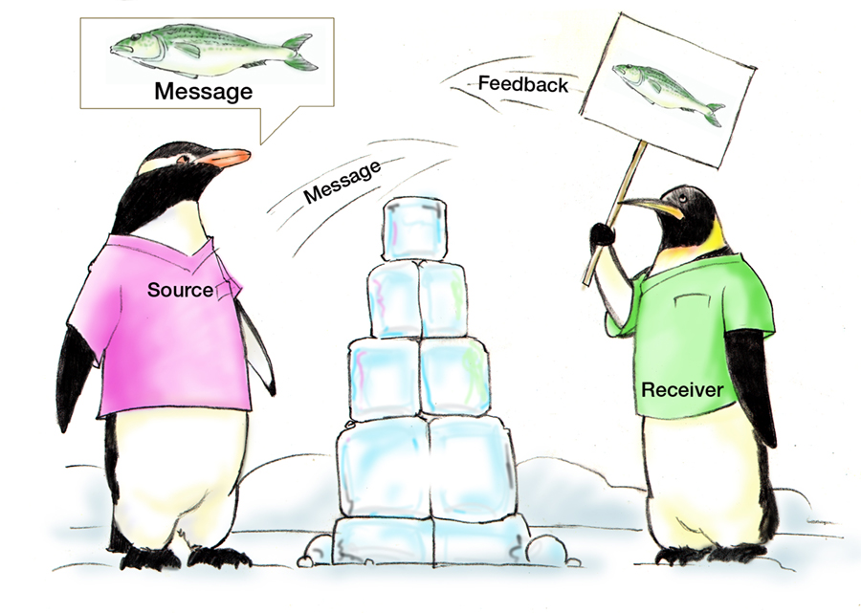
Communication
The process by which people exchange information or express their thoughts and feelings.
Whereas, Communication skills are the ability to use language(receptive) and express(expressive) information.
Receptive- Verbal
Expressive- Non Verbal
Assumptions
Fatigue
Distractions

Slide 4
Communication through formal channel
Manager to Employee Employee to Manager
i.e. Job plans, Company i.e. feedback, progress reports
goals etc
Horizontal
Downwards
Among Employee
Upwards

Slide 5
Effective Communication
Definition:
“Effective Communication is the communication which produces intended or desired results/
Outcomes.”
Effective Communication is a two way process- sending the right message and to right person or entity.
It is important to know the psychology of the people you are interacting with for communication to be effective.
Effective when it permeates every aspect of an organization.

Slide 6
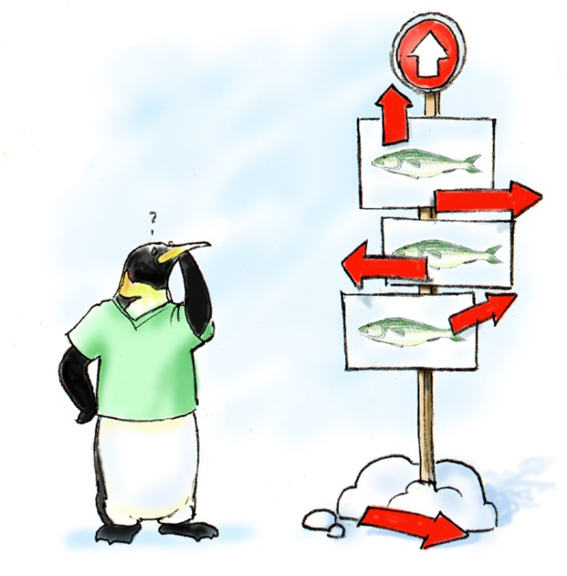
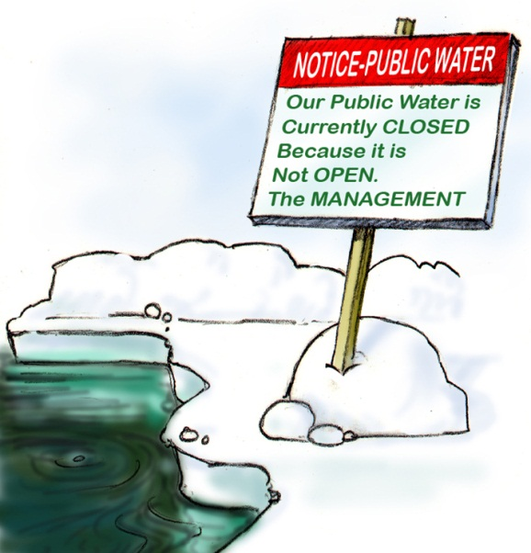
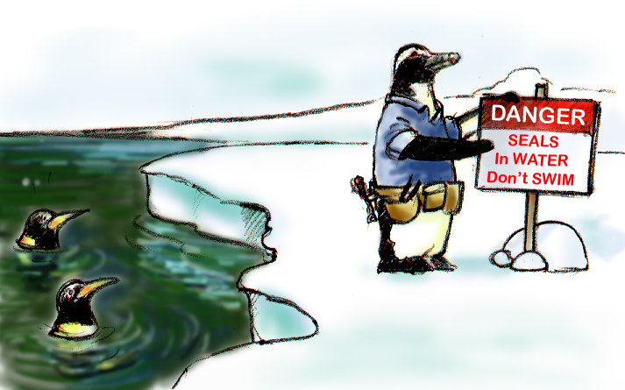
Standards of Effective Communication
Brief
Clear
Complete
Clear
Brief
Timely
Timely

Slide 7
7 C’S OF Effective COMMUNICATION
Completeness
Conciseness
Consideration
Clarity
Concreteness
Courtesy
Correctness

Slide 8
Barriers in Effective Communication
Semantic Barriers
Symbols with different meaning
Badly expressed message
Un-clarified assumption
Emotional or Phycological Barriers
Premature evolution
Inattention
Loss of transmission & poor retention

Slide 9
Barriers in Effective Communication(cont.)
Organization Barriers
Status & relation
Organizational rules & regulation
Complexity in organization
Personal Barriers
Barriers in superior
Attitude of superior, lack of time or awareness.
Barriers in subordinates
Lack of proper initiative, unwillingness to communicate.

Slide 10
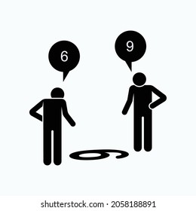
Miscommunication
If Communication is action/transaction, so miscommunication can be viewed as instances of action/transaction failure.
“When the speaker fails to produce the intended effect.”
The unintentional transmission of incorrect or unclear messages.
Can lead to misunderstandings, conflict, and negative outcomes.

Slide 11
Strategies for mitigating miscommunication
Clarification | Cultural Sensitivity | Feedback Mechanisms
Asking questions for better understanding | Awareness & respect for cultural differences | Encouraging open feedback and Comments.
Seeking clarification to avoid assumptions | Adaptation of communication styles | Regular Check-ins to address concerns

Slide 12
Guidelines to becoming a Good communicator
Adopt an audience- centred approach
Foster open communication
Create clean, efficient messages
Give up Laziness!(Biggest RED flag)
Be Ethical in your communications

Slide 13
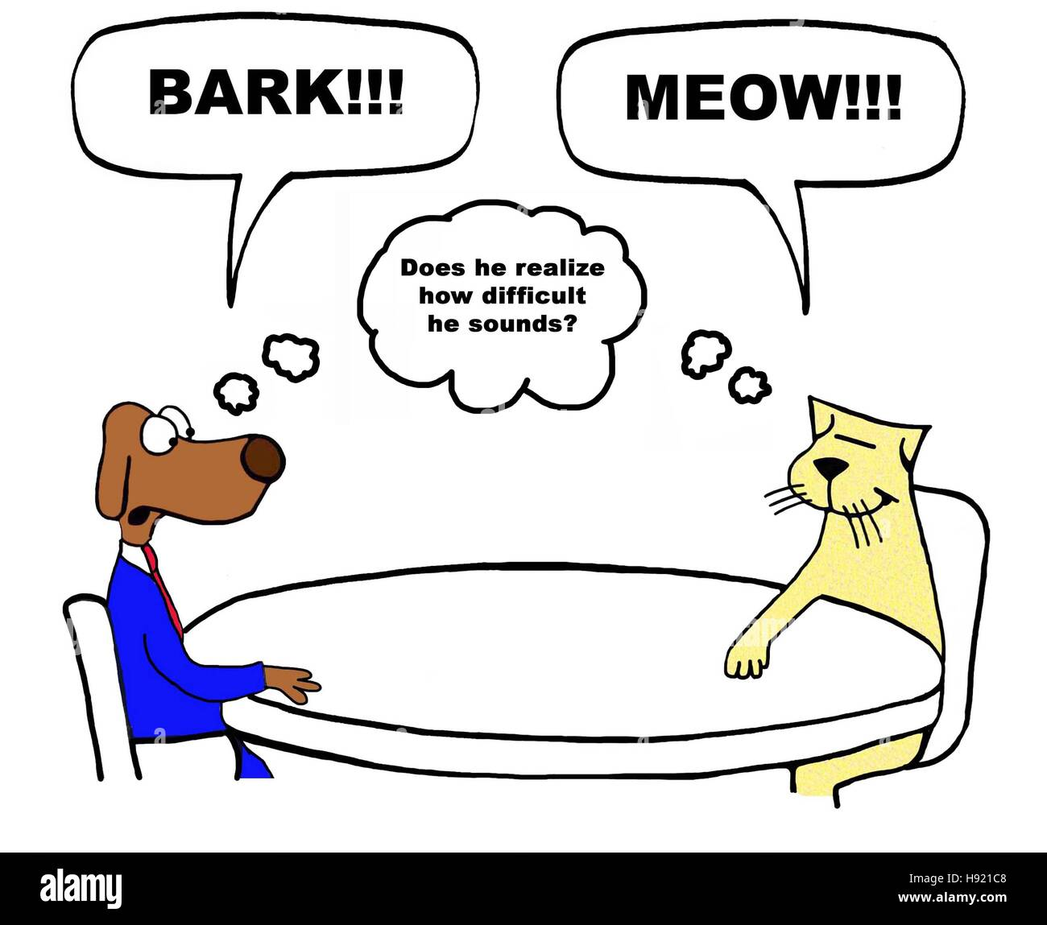
“If you can't communicate and talk to other people and get across your ideas, you're giving up your potential.”
-Warren Buffet

Slide 14
Any Questions?
THANK YOU
Himanshu Singh
himanshushps33@gmail.com
github.com/HimanshuSinghasDS

